Slide 1


FAKEQUIPO
Save yourself from being counterfeited!!
DE_FACTO CRYPTERS
TEAM MEMBERS
DHARSHINI T
SWETHA LAKSHME S
THOSHINNY B
HackOFiesta-Flagship Hackathon of India
01

Slide 2
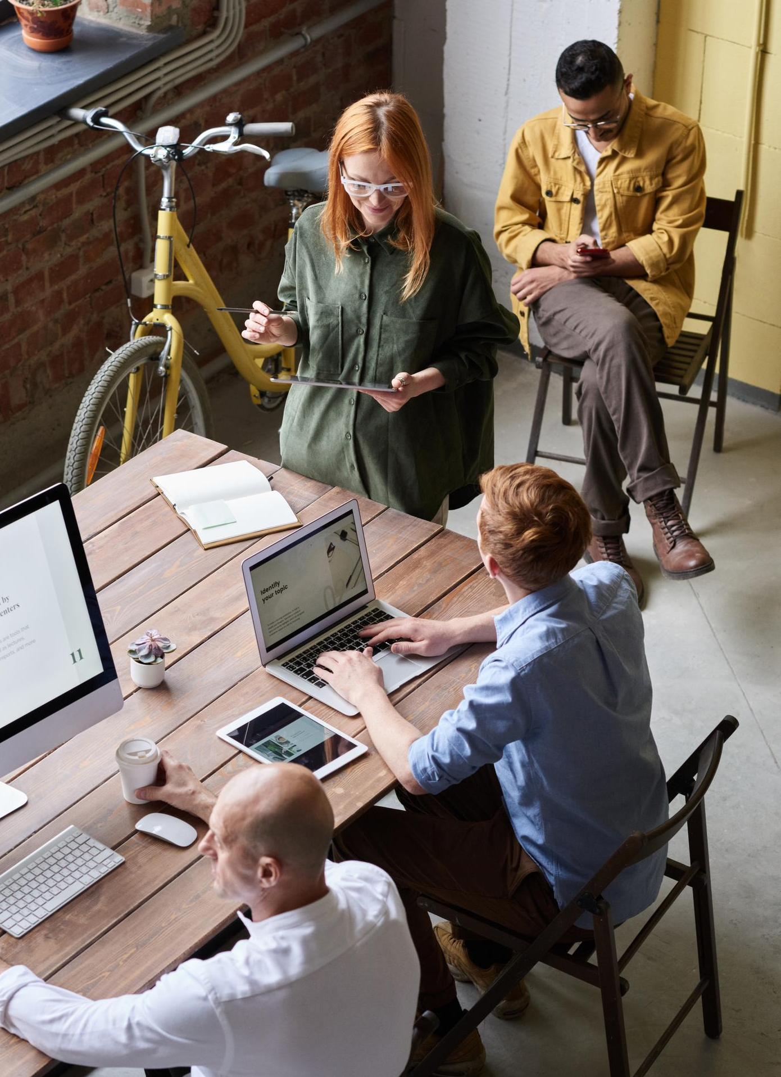

PROBLEM STATEMENT
ANY RELEVANT GRAPHIC
One in five drugs sold in India is counterfeit, according to the Associated Chambers of Commerce and Industry of India (Assocham). Worldwide, 35% of all fake drugs originate in India, according to the business organization, in a special report which has been submitted to the Indian federal government.
So inorder to get rid of counterfeited medicines we came up with a solution that is our fakequipo.

Slide 3

PROPOSED SOLUTION
Fakequipo is a product authentication and consumer engagement company that helps in analyzing counterfeit medicines. The main moto of our website is save people from being counterfeited. We have separate login pages for Consumer, Manufacturer and Supplier. When the manufacturer registers with us for the first time, we get their like
Manufacturing Company name, address, phone number, Government verified license etc. After verifying the credentials submitted by them we send them a verification mail and get the information related to Total supply of medicines, Medicine name, dosage of medicines supplied, Manufacturing Date of medicines, Expiry date of
medicines in an excel format. After which we generate QR Codes for the same and it can be downloaded from our website. Then these QR codes are attached with the medicines they distribute. In the supplier login, supplier associated with these manufacturer should register themselves in our website and provide the details like Supplier Name, Supplying Company name, Address, Phone number, Government verified license So, when the supplier gets the medicines from the manufacturer, they can upload the QR Code present in the medicines and can check if the medicine is fake or not. Similarly, the consumer can register in our website and can check the correctness of the medicine by uploading the QR Code image present in the medicine in our website and thus check if medicine is fake or not. We have used block chain to store the data. In block chain, the acting roles are consumer, manufacturer, supplier. By using local block chain ganache, we get the addresses of these data and import it to metamask and check the transaction. By doing this we ensure traceability, security and serializibility

Slide 4

4.
UNIQUE SELLING POINTS
Real time database management system and Dapp
management..
1.
Greater Transparency and Traceability.
5.
Just one-click save yourself from being counterfeited.
2.
Distributed data:
Since the data in our we website are decentralized, the system and data are highly resistant to malicious attacks.
6.
Our user friendly chat bot ”crypto” helps the user to get the required data within a fraction of second.
3.
Informative blog to keep yourself updated about medical scams and counterfeit medicines.
7.
All safe medicines under one roof.

Slide 5

YOUR TECH STACK
1.
FRONT END:
.
HTML, CSS, JS and Bootstrap:
HTML provides the basic structure of site which is enhanced and modified with CSS,
JS and bootstrap. CSS is used to control presentation, formatting, and layout. JS and
bootstrap is used to control the behaviour of different elements. All to these elements
are used in our website for frontend implementation.
2.
BACK END:
Truffle suite-for smart contracts compilation
ganache-local block chain network
solidity-language to create smart contracts
web3-to make smart contracts to interact with the UI
3.
OTHER TECH
Google Firebase:
A Google-backed application development software used in our website for
user login credentials and storage of data.
IBM Watson:
IBM Watson Assistant is used in our website to build a user-friendly chatbot.

Slide 6
THANK YOU

